Slide 1
19CSE305: MACHINE LEARNING

Slide 2
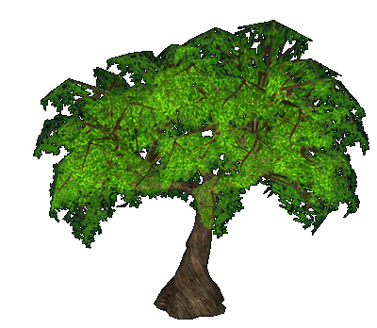
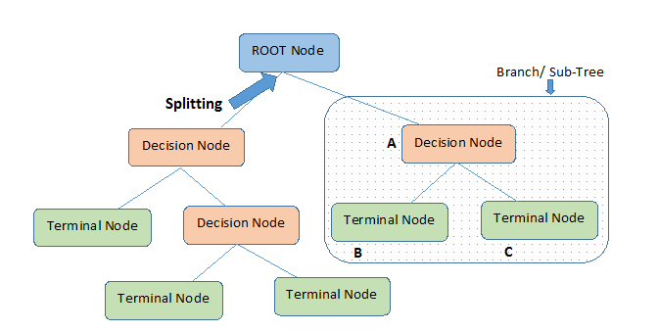
Decision Trees

Slide 3
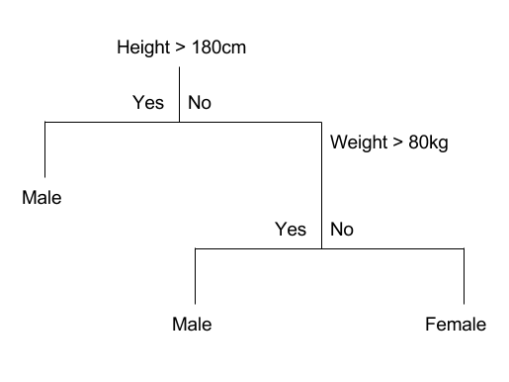
Decision Trees

Slide 4
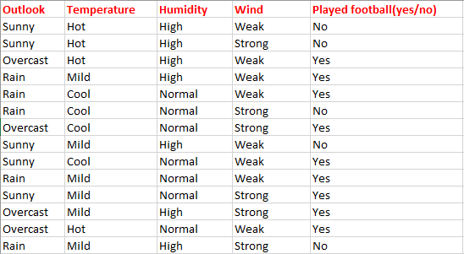
Decision Trees
Consider whether a dataset based on which we will determine whether to play football or not.

Slide 5
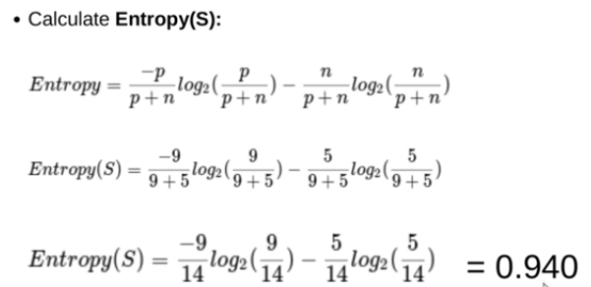
Contd…

Slide 6
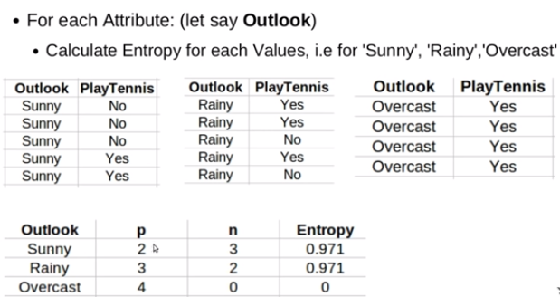
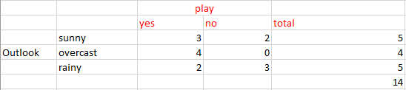
Contd…

Slide 7
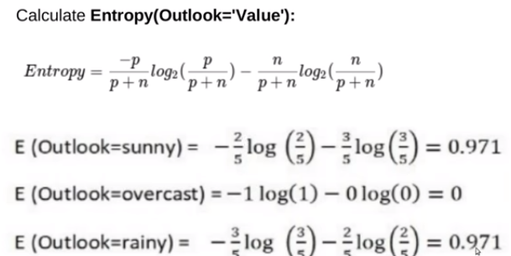
Contd…

Slide 8
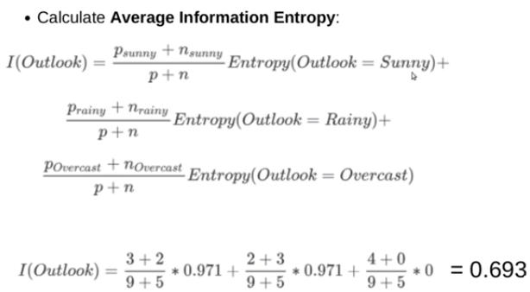
calculate average weighted entropy. ie, we have found the total of weights of each feature multiplied by probabilities.
E(S, outlook) = (5/14)*E(3,2) + (4/14)*E(4,0) + (5/14)*E(2,3)
= (5/14)(-(3/5)log(3/5)-(2/5)log(2/5))+ (4/14)(0) +
(5/14)((2/5)log(2/5)-(3/5)log(3/5))

Slide 9
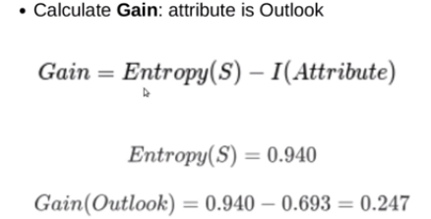
Contd…

Slide 10
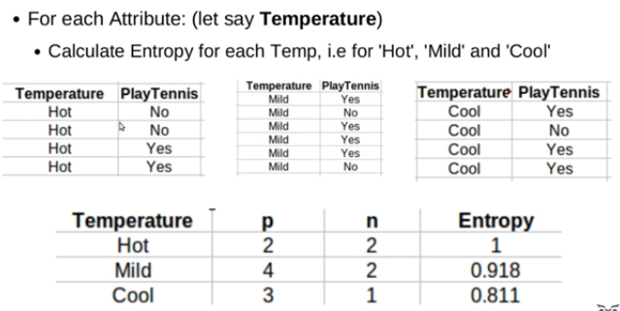
Contd…
Calculate Entropy for Temperature=Hot,Mild,Cool

Slide 11
Contd…

Slide 12
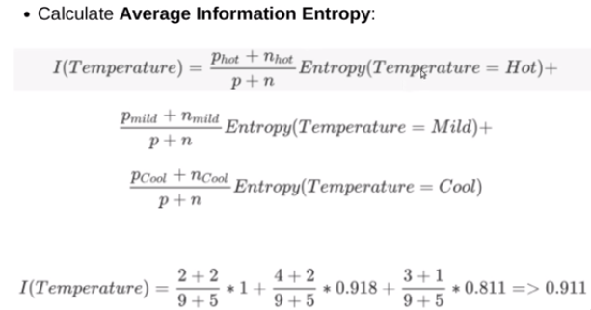
Contd…

Slide 13
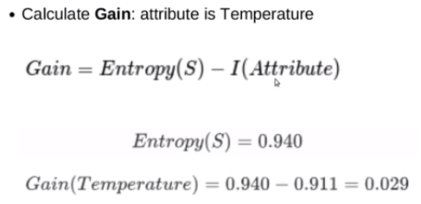
Contd…

Slide 14
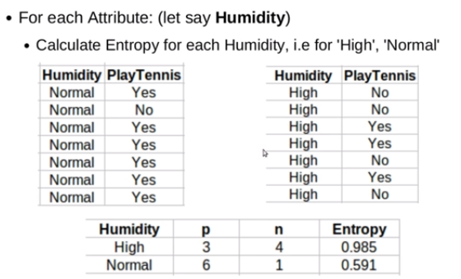
Contd…

Slide 15
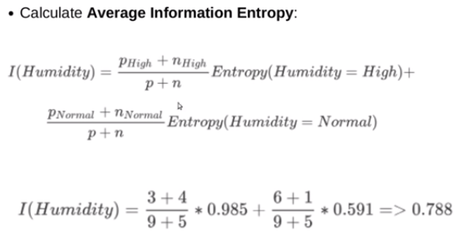
Contd…

Slide 16
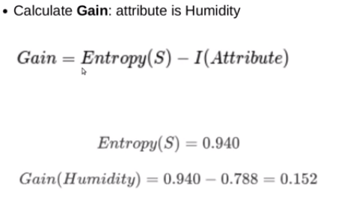
Contd…

Slide 17
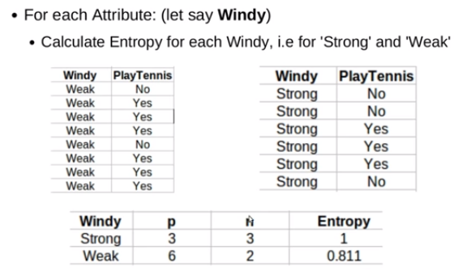
Contd…

Slide 18
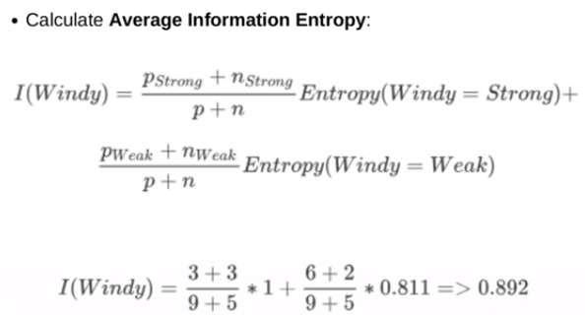
Contd…

Slide 19
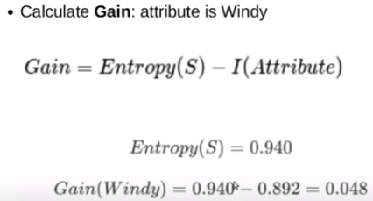
Contd…

Slide 20
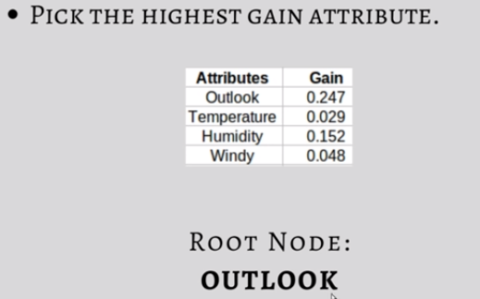
Contd…

Slide 21
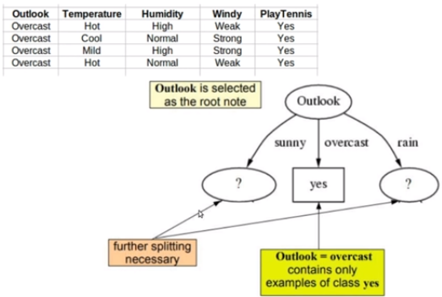
Contd…

Slide 22
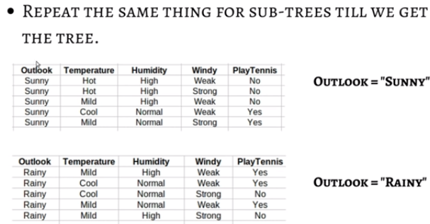
Contd…

Slide 23
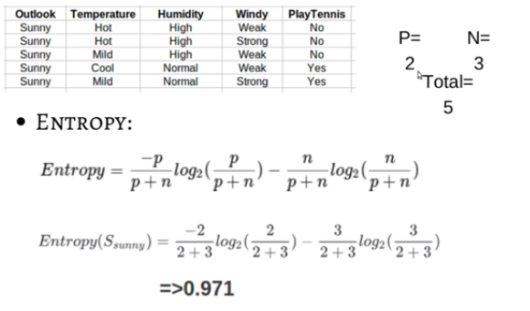
Contd…

Slide 24
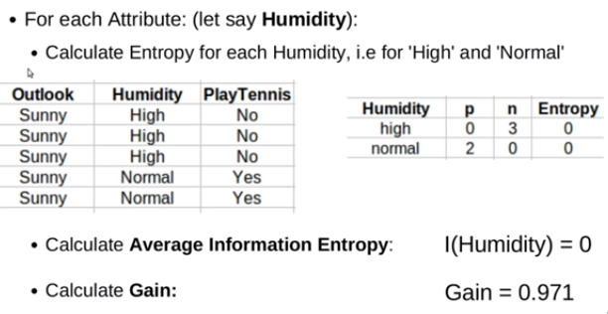
Contd…

Slide 25
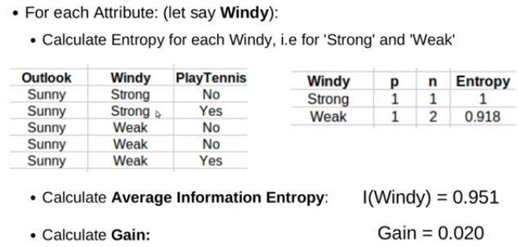
Contd…

Slide 26
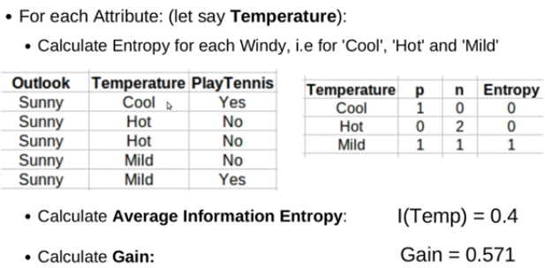
Contd…

Slide 27
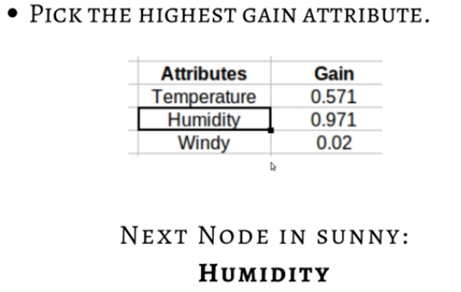
Contd…

Slide 28
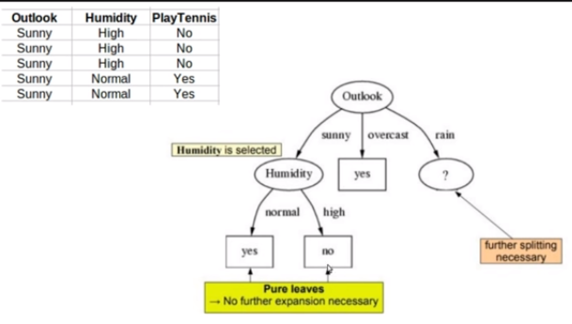
Contd…

Slide 29
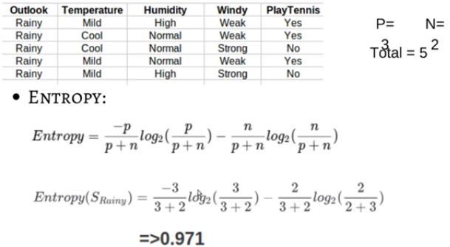
Contd…

Slide 30
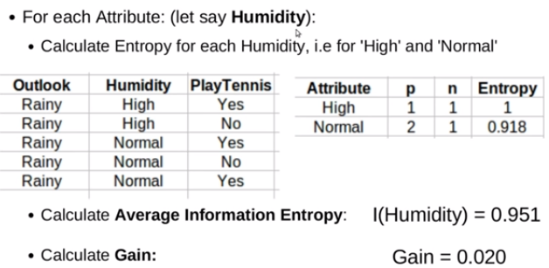
Contd…

Slide 31
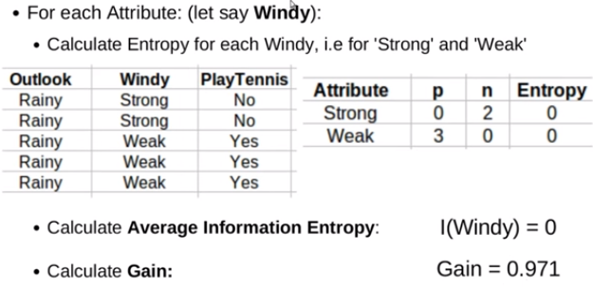
Contd…

Slide 32
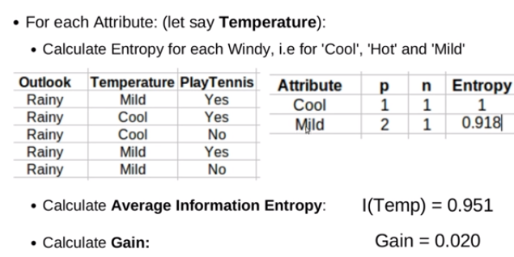
Contd…

Slide 33
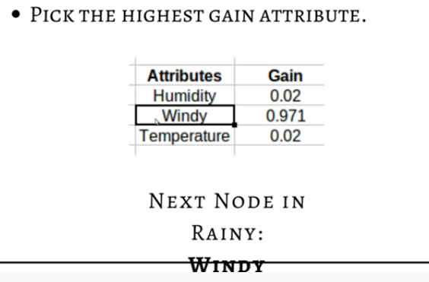
Contd…

Slide 34
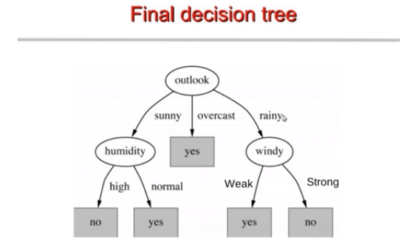
Contd…

Slide 35
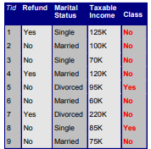
Example 2

Slide 36
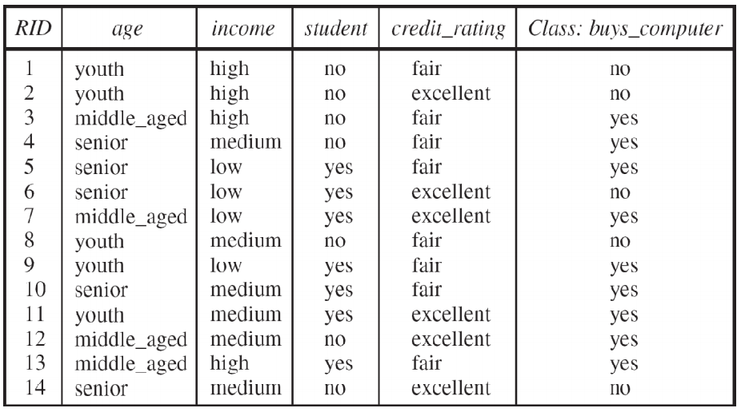
Example 3

Slide 37
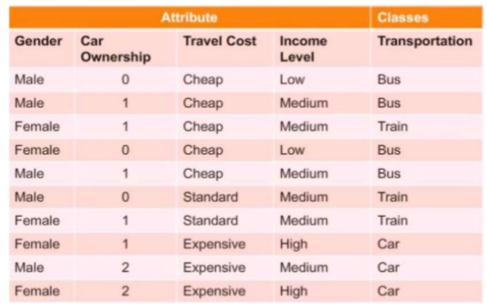
Example 4

Slide 38
Example 5
Lead Actor | Genre | Hit(Y/N)
Amitabh Bacchan | Action | Yes
Amitabh Bacchan | Fiction | Yes
Amitabh Bacchan | Romance | No
Amitabh Bacchan | Action | Yes
Abhishek Bacchan | Action | No
Abhishek Bacchan | Fiction | No
Abhishek Bacchan | Romance | Yes

Slide 39
THANK YOU

